Slide 1
Community Cookbooks
Introducing the chef-client cookbook & wrapper cookbooks

Slide 2
Lesson Objectives
After completing the module, you will be able to
Find, preview and download cookbooks from the Chef Supermarket
Use knife to work with the Chef Supermarket site API
Override community cookbook defaults using wrapper cookbooks
Upload community cookbooks to Chef Server
Run chef-client as a service/task

Slide 3
Community Cookbooks
Someone already wrote that cookbook?
Available through the community site called Supermarket/
https://supermarket.chef.io
Notes:
But what if we told you someone already wrote that cookbook?
Someone already has and that cookbook is available through the community site called Supermarket. Supermarket is a public repository of all the cookbooks shared by other developers, teams, and companies who want to share their knowledge and hard work with you to save you time.

Slide 4
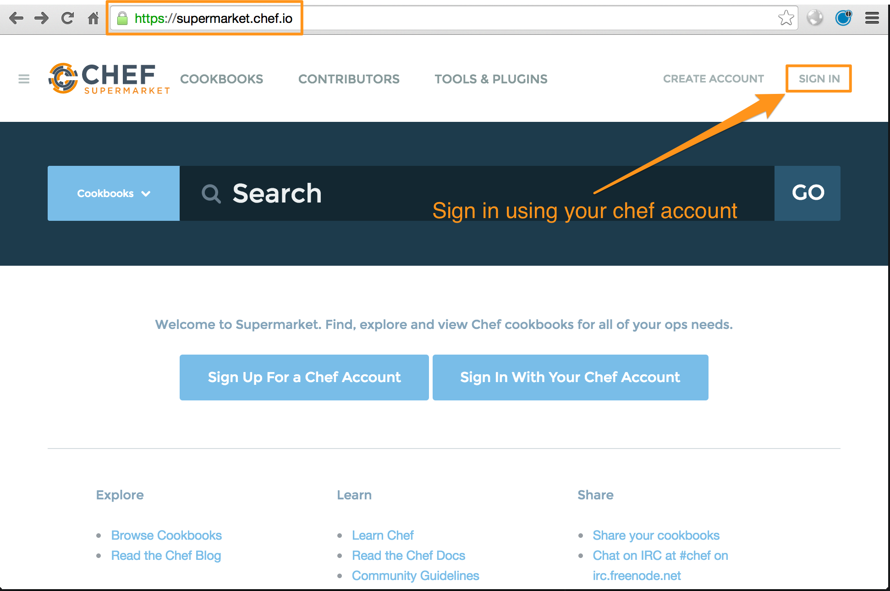
Log into Supermarket

Slide 5
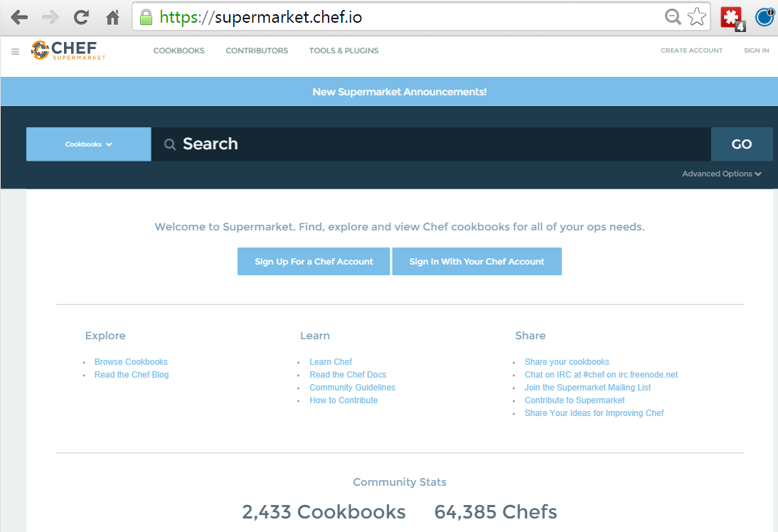
Community Cookbooks
Community cookbooks are managed by individuals.
Chef does not verify or approve cookbooks in the Supermarket.
Cookbooks may not work for various reasons.
Still, there are real benefits to community cookbooks.
Notes:
An important thing to remember is that on the community site are cookbooks managed by individuals. Chef does not verify or approve the cookbooks found in the Supermarket. These cookbooks solved problems for the original authors and then they decided to share them. This means that the cookbooks you find in the Supermarket may not be built or designed for your platform. It may not take into special consideration your needs and requirements. It may no longer be actively maintained.
Even if the cookbook does not work as a whole, there is still value in reading and understand the source code and extracting the pieces you need when creating your own. With all that said, there is a real benefit to the community site. When you find a cookbook that helps you deliver value quickly, it can be a tremendous boon to your productivity. This is what we are going to take advantage of with the haproxy cookbook.

Slide 6
Step back: How how is chef-client configured
How can I run chef-client as a service or Windows task?
Where can I configure logging?
How does chef-client know what Chef Server to connect to?
How does chef-client authenticate with the Chef Server?
How do I configure where chef-client caches?

Slide 7
GE: View chef-client config directory
$ knife ssh "*:*" -x USER -P PWD "ls -F /etc/chef"
ec2... client.pem client.rb first-boot.json ohai/ validation.pem
ec2... client.pem client.rb first-boot.json ohai/ validation.pem
ec2... client.pem client.rb first-boot.json ohai/ validation.pem
Notes:
Its using our full-stack installation path automatically, and the -d says "runs as a daemon in the background"
We log to /var/log/chef/client.log (configurable). The -i is the interval, a number of seconds (30 minutes here) (configurable) and the last bit is splay (mitigating the thundering herd problem)
Note: embdded dir path -- talk about Omnibus installer if not mentioned already

Slide 8
GE: View chef-client configuration
$ knife ssh "*:*" -x USER -P PWD "cat /etc/chef/client.rb"
ec2... log_location STDOUT
ec2... chef_server_url "https://api.chef.io/organizations/jaf-291015"
ec2... validation_client_name "ORG-validator"
ec2... node_name "node3"
ec2...
ec2... log_location STDOUT
ec2... chef_server_url "https://api.chef.io/organizations/jaf-291015"
ec2... validation_client_name "ORG-validator"
ec2... node_name "node1"
ec2...
ec2... log_location STDOUT
ec2... chef_server_url "https://api.chef.io/organizations/jaf-291015"
ec2... validation_client_name "ORG-validator"
ec2... node_name "node2"
Notes:
Its using our full-stack installation path automatically, and the -d says "runs as a daemon in the background"
We log to /var/log/chef/client.log (configurable). The -i is the interval, a number of seconds (30 minutes here) (configurable) and the last bit is splay (mitigating the thundering herd problem)
Note: embdded dir path -- talk about Omnibus installer if not mentioned already

Slide 9
Introducing chef-client cookbook
The Chef-client cookbook allows you to manage and configure chef-client as a service on Linux based nodes, or as a Task on Windows nodes, configure logging, caching, etc
Bootstrapping installs chef-client executable
The chef-client cookbook is used to configure chef-client

Slide 10
Introducing chef-client cookbook
We will use the chef-client community cookbook to configured chef-client on each of our nodes to run periodically
Download chef-client cookbook & upload to Chef Server
Configure each of our nodes to run chef-client as a service

Slide 11
GE: Use knife to search the Chef Supermarket
$ knife cookbook site search chef-client
chef:
cookbook: http://cookbooks.opscode.com/api/v1/cookbooks/chef
cookbook_description: Installs and configures Chef for chef-client and chef-server
cookbook_maintainer: opscode
cookbook_name: chef
chef-client:
cookbook: http://cookbooks.opscode.com/api/v1/cookbooks/chef-client
cookbook_description: Manages client.rb configuration and chef-client service
cookbook_maintainer: opscode
cookbook_name: chef-client
chef-client-cron:
cookbook: http://cookbooks.opscode.com/api/v1/cookbooks/chef-client-cron
cookbook_description: Manages aspects of only chef-client
cookbook_maintainer: bryanwb
cookbook_name: chef-client-cron
chef-client_syslog:
cookbook: http://cookbooks.opscode.com/api/v1/cookbooks/chef-client_syslog
cookbook_description: chef-client logg to syslog
cookbook_maintainer: sawanoboly
cookbook_name: chef-client_syslog
Notes:
The search command simply takes a single parameter as the query. It doesn't require the field:pattern format like Chef server search. It will return all the results.

Slide 12
GE: Use knife to show the chef-client cookbook in Supermarket
$ knife cookbook site show chef-client
average_rating: 4.85714
category: Utilities
created_at: 2010-12-16T23:00:45Z
description: Manages client.rb configuration and chef-client service
external_url: github.com/opscode-cookbooks/chef-client
latest_version: http://cookbooks.opscode.com/api/v1/cookbooks/chef-client/versions/3_2_0
maintainer: opscode
name: chef-client
updated_at: 2013-12-19T19:02:44Z
versions:
http://cookbooks.opscode.com/api/v1/cookbooks/chef-client/versions/3_2_0
http://cookbooks.opscode.com/api/v1/cookbooks/chef-client/versions/3_1_2
http://cookbooks.opscode.com/api/v1/cookbooks/chef-client/versions/3_1_0

Slide 13
GE: Download the chef-client cookbook
$ knife cookbook site download chef-client
Downloading chef-client from the cookbooks site at version 4.3.1 to /Users/.../chef-repo/chef-client-4.3.1.tar.gz
Cookbook saved: /Users/.../chef-repo/chef-client-4.3.1.tar.gz
Notes:
Savvy students may notice that we have a "knife cookbook site install" command as well that does the whole download-untar-get-dependencies incantation.
Only problem is that it does all kinds of stuff with vendor branches and tags in Git that may not be desireable, so here’s where you can mention that.

Slide 14
GE: Extract chef-client cookbook tarball
$ tar -zxvf chef-client*.tar.gz -C cookbooks/
x chef-client/
x chef-client/attributes/
x chef-client/CHANGELOG.md
x chef-client/CONTRIBUTING
x chef-client/LICENSE
x chef-client/metadata.json
x chef-client/metadata.rb
x chef-client/README.md
x chef-client/recipes/
x chef-client/templates/
x chef-client/templates/arch/
x chef-client/templates/default/
x chef-client/templates/windows/
x chef-client/templates/default/debian/
x chef-client/templates/default/redhat/
x chef-client/templates/default/solaris/
x chef-client/templates/arch/conf.d/
x chef-client/templates/arch/rc.d/
x chef-client/recipes/config.rb
x chef-client/recipes/cron.rb
x chef-client/recipes/default.rb
x chef-client/recipes/delete_validation.rb
x chef-client/recipes/service.rb
x chef-client/attributes/default.rb
Notes:
Note: Windows users cannot use *, they must pass in the full file name
Savvy students may notice that we have a "knife cookbook site install" command as well that does the whole download-untar-get-dependencies incantation.
Only problem is that it does all kinds of stuff with vendor branches and tags in Git that may not be desireable, so here’s where you can mention that.

Slide 15
Examining the chef-client cookbook
We're going to use one recipe on our node from the chef-client cookbook.
chef-client::service (via chef-client::default)

Slide 16
View the chef-client::default recipe
cookbooks/chef-client/recipes/default.rb
#
# Unless required by applicable law or agreed to in writing, software
# distributed under the License is distributed on an "AS IS" BASIS,
# WITHOUT WARRANTIES OR CONDITIONS OF ANY KIND, either express or implied.
# See the License for the specific language governing permissions and
# limitations under the License.
#
include_recipe "chef-client::service"

Slide 17
View the chef-client::service recipe
cookbooks/chef-client/recipes/service.rb
The recipe supports a number of service providers and styles.
It works on a lot of platforms.
Everything is controllable through attributes.
supported_init_styles = [
'arch',
'bluepill',
'bsd',
'daemontools',
'init',
'launchd',
'runit',
'smf',
'upstart',
'winsw'
]
init_style = node["chef_client"]["init_style"]
# Services moved to recipes
if supported_init_styles.include? init_style
include_recipe "chef-client::#{init_style}_service"
else
log "Could not determine service init style, manual intervention required to start up the chef-client service."
end
Notes:
There's a lot to this recipe. We're not going to cover it in detail, you can read it on your own.
There are several init styles that can be selected by setting the node attribute in the recipe. "init" is the default, and what we're going to use. Also available: smf, upstart, arch, runit, bluepill, daemontools, winsw. "cron" is a separate recipe since it is not technically running as a "service".

Slide 18
Issue!
We cannot use berks with the cookbook downloaded using knife
It has no metadata.rb!
Stove refuses to upload metadata.rb because it's vulnerable to fairly serious abuse

Slide 19
GE: Download & unpack chef-client cookbook
$ cd ~/chef-repo
$ wget https://github.com/opscode-cookbooks/chef-client/archive/master.zip
$ unzip master.zip -d cookbooks
$ mv cookbooks/chef-client-master/ cookbooks/chef-client/
Or manually create file from here
https://github.com/chef-cookbooks/chef-client/blob/master/metadata.rb
Notes:
https://github.com/chef-cookbooks/chef-client/archive/v4.3.0.zip

Slide 20
GE: Lets view the dependencies
$ cd cookbooks/chef-client
$ cat Berksfile
source 'https://supermarket.chef.io'
metadata
group :integration do
cookbook 'runit'
cookbook 'apt'
cookbook 'chef-server', '>= 3.0.0'
end

Slide 21
GE: Install the Dependencies
$ berks install
Resolving cookbook dependencies...
Fetching 'chef-client' from source at .
Fetching cookbook index from https://supermarket.chef.io...
Installing apt (2.9.2) from https://supermarket.chef.io ([opscode] https://supermarket.chef.io:443/api/v1)
Installing apt-chef (0.2.0) from https://supermarket.chef.io ([opscode] https://supermarket.chef.io:443/api/v1)
Installing chef-ingredient (0.13.1) from https://supermarket.chef.io ([opscode] https://supermarket.chef.io:443/api/v1)
Using chef-client (4.3.1) from source at .
Installing chef-server (4.1.0) from https://supermarket.chef.io ([opscode] https://supermarket.chef.io:443/api/v1)
Using chef_handler (1.2.0)
Using logrotate (1.9.2)
Installing cron (1.7.0) from https://supermarket.chef.io ([opscode] https://supermarket.chef.io:443/api/v1)
Using packagecloud (0.1.0)
Using runit (1.7.4)
Installing windows (1.38.2) from https://supermarket.chef.io ([opscode] https://supermarket.chef.io:443/api/v1)
Installing yum (3.8.2) from https://supermarket.chef.io ([opscode] https://supermarket.chef.io:443/api/v1)
Installing yum-chef (0.2.1) from https://supermarket.chef.io ([opscode] https://supermarket.chef.io:443/api/v1)

Slide 22
Whats in the Berksfile.lock?
$ cat Berksfile.lock
DEPENDENCIES
apt
chef-client
path: .
metadata: true
chef-server (>= 3.0.0)
runit
GRAPH
apt (2.9.2)
apt-chef (0.2.0)
apt (>= 0.0.0)
chef-client (4.3.1)
cron (>= 1.2.0)
logrotate (>= 1.2.0)
...

Slide 23
View the Berkshelf in your home directory
$ ls -lt ~/.berkshelf/cookbooks/
drwxr-xr-x 12 YOU staff 408 2 Dec 15:46 chef_handler-1.1.6
drwxr-xr-x 12 YOU staff 408 2 Dec 15:46 cron-1.6.1
drwxr-xr-x 21 YOU staff 714 2 Dec 15:46 logrotate-1.8.0
drwxr-xr-x 15 YOU staff 510 2 Dec 15:46 windows-1.36.6
drwxr-xr-x 9 YOU staff 306 28 Nov 15:22 build-essential-2.1.3
drwxr-xr-x 25 YOU staff 850 6 Nov 16:27 build-essential-2.1.2
drwxr-xr-x 11 YOU staff 374 6 Nov 16:27 cpu-0.2.0

Slide 24
Upload cookbooks to Chef Server
$ berks upload
Uploaded apt (2.9.2) to: 'https://api.chef.io:443/organizations/ORG'
Uploaded apt-chef (0.2.2) to: 'https://api.chef.io:443/organizations/ORG'
Uploaded chef-client (4.3.2) to: 'https://api.chef.io:443/organizations/ORG'
Uploaded chef-ingredient (0.11.3) to: 'https://api.chef.io:443/organizations/ORG'
Uploaded chef-server (4.1.0) to: 'https://api.chef.io:443/organizations/ORG'
Uploaded chef_handler (1.2.0) to: 'https://api.chef.io:443/organizations/ORG'
Uploaded cron (1.7.3) to: 'https://api.chef.io:443/organizations/ORG'
Uploaded logrotate (1.9.2) to: 'https://api.chef.io:443/organizations/ORG'
Uploaded packagecloud (0.1.1) to: 'https://api.chef.io:443/organizations/ORG'
Uploaded runit (1.7.6) to: 'https://api.chef.io:443/organizations/ORG'
Uploaded windows (1.39.0) to: 'https://api.chef.io:443/organizations/ORG'
Uploaded yum (3.8.2) to: 'https://api.chef.io:443/organizations/ORG'
Uploaded yum-chef (0.2.2) to: 'https://api.chef.io:443/organizations/ORG'

Slide 25
View cookbooks on Chef Server
$ knife cookbook list
apache 0.3.0
apt 2.9.2
apt-chef 0.2.0
chef-client 4.3.1
chef_handler 1.2.0
cron 1.7.0
haproxy 0.2.0
logrotate 1.9.2
starter 1.0.0
windows 1.38.2
workstation 0.2.1
...

Slide 26
Introducing chef-client cookbook
We will use the chef-client community cookbook to configured chef-client on each of our nodes to run periodically
Download chef-client cookbook & upload to Chef Server
Configure each of our nodes to run chef-client as a service

Slide 27
chef-client as a service
We will add the chef-client default recipe to the roles for each node

Slide 28
GE: Add the recipe to the file web.rb
~/chef-repo/roles/web.rb
name 'web'
description 'Web Server'
run_list 'recipe[chef-client]', 'recipe[apache]'
default_attributes({
"apache" => {
"port" => 8181
}
})
Notes:
First we create a file named web.rb in the roles directory.
The name of the role is web. The description should be Web Server. The run list you define should contain the apache cookbook's default recipe.

Slide 29
GE: Add the recipe to the file proxy.rb
~/chef-repo/roles/loadbalancer.rb
name 'loadbalancer'
description 'loadbalancer'
run_list 'recipe[chef-client]', 'recipe[haproxy]'
default_attributes({
"apache" => {
"port" => 8181
}
})
Notes:
Create a file named proxy.rb. This is a ruby file that contains specific methods that allow you to express details about the role. You'll see that the role has a name, a description, and run list.
The name of the role as a practice will share the name of the ruby file unless it cannot for some reason. The name of the role should clearly describe what it attempts accomplish.
The description of the role helps reinforce or clarify the intended purpose of the role. When selecting a role name that is not clear it is important that a helpful description is provided to help ensure everyone on the team understands its purpose.
The run list defines the list of recipes that give the role its purpose. Currently the proxy role defines a single recipe - the myhaproxy cookbook's default recipe.

Slide 30
GE: Upload the roles files
$ knife role from file web.rb loadbalancer.rb
Updated Role web!
Updated Role loadbalancer!
Notes:
You need to share the role with the Chef Server so upload that file.
Use the command 'knife role from file web.rb'. 'knife' knows where to look for that role to upload it.

Slide 31
GE: Converge All Nodes
$ knife ssh "*:*" -x USER -P PWD "sudo chef-client"
ec2-54-88-169-195.compute-1.amazonaws.com Starting Chef Client, version 12.4.4
ec2-54-88-185-159.compute-1.amazonaws.com Starting Chef Client, version 12.4.4
ec2-54-84-233-7.compute-1.amazonaws.com Starting Chef Client, version 12.4.4
ec2-54-88-185-159.compute-1.amazonaws.com resolving cookbooks for run list: ["apache", "chef-client"]
ec2-54-88-169-195.compute-1.amazonaws.com resolving cookbooks for run list: ["haproxy", "chef-client"]
ec2-54-84-233-7.compute-1.amazonaws.com resolving cookbooks for run list: ["apache", "chef-client"]
ec2-54-88-185-159.compute-1.amazonaws.com Synchronizing Cookbooks:
ec2-54-88-169-195.compute-1.amazonaws.com Synchronizing Cookbooks:
ec2-54-84-233-7.compute-1.amazonaws.com Synchronizing Cookbooks:
...
Notes:
To verify that everything is working the same as before, run 'knife ssh' for both of these nodes. In this instance the query syntax is going to find all nodes with the role set to web.

Slide 32
GE: Verify chef-client is running
$ knife ssh "*:*" -x USER -P PWD "ps awux | grep chef-client"
ec2-54-88-185-159.compute-1.amazonaws.com root 10369 0.0 10.1 266928 61116 ? Sl 12:54 0:00 /opt/chefdk/embedded/bin/ruby /usr/bin/chef-client -d -c /etc/chef/client.rb -P /var/run/chef/client.pid -i 1800 -s 300
...
ec2-54-88-169-195.compute-1.amazonaws.com root 14922 0.0 10.1 267020 61092 ? Sl 12:54 0:00 /opt/chefdk/embedded/bin/ruby /usr/bin/chef-client -d -c /etc/chef/client.rb -P /var/run/chef/client.pid -i 1800 -s 300
...
ec2-54-84-233-7.compute-1.amazonaws.com root 10202 0.0 10.1 267036 61096 ? Sl 12:54 0:00 /opt/chefdk/embedded/bin/ruby /usr/bin/chef-client -d -c /etc/chef/client.rb -P /var/run/chef/client.pid -i 1800 -s 300
...
Notes:
Its using our full-stack installation path automatically, and the -d says "runs as a daemon in the background"
We log to /var/log/chef/client.log (configurable). The -i is the interval, a number of seconds (30 minutes here) (configurable) and the last bit is splay (mitigating the thundering herd problem)
Note: embdded dir path -- talk about Omnibus installer if not mentioned already

Slide 33
Introducing chef-client cookbook
We will use the chef-client community cookbook to configured chef-client on each of our nodes to run periodically
Download chef-client cookbook & upload to Chef Server
Configure each of our nodes to run chef-client as a service

Slide 34
Change default settings
Wait!
There has just been a mandate that every node in the infrastructure must run chef-client every 5 minutes
Further this must be the new default setting for anyone downloading the chef-client cookbook

Slide 35
Well-written cookbooks change behavior based on attributes
Ideally, you don't have to modify the contents of a cookbook to use it for your specific use case
Look at the attributes for things you can override through roles to affect behavior of the cookbook
Of course, well written cookbooks have sane defaults, and a README to describe all this
Notes:
See https://www.chef.io/blog/2013/12/03/doing-wrapper-cookbooks-right/

Slide 36
Setting the chef-client run interval
...
default['chef_client']['log_file'] = 'client.log'
default['chef_client']['interval'] = '1800'
default['chef_client']['interval'] = '300'
default['chef_client']['splay'] = '300'
default['chef_client']['conf_dir'] = '/etc/chef'
default['chef_client']['bin'] = '/usr/bin/chef-client'
...
We need to change the value of the attribute default['chef_client']['interval'] from to 1800 (seconds) to 300
Notes:
So we need to change the attribute default['chef_client']['interval'] in chef-client cookbook
But what if a new cookbook version is released & we want to upgrade to it?
We'd need to reimplement these changes!
Maintenance nightmare – especially if its been refactored!

Slide 37
Wrapper Cookbooks
Don't use forked community cookbooks in production, or you will miss out on upstream changes, and will have to rebase
Instead use wrapper cookbooks to wrap upstream cookbooks and change their behavior without forking
Notes:
See https://www.chef.io/blog/2013/12/03/doing-wrapper-cookbooks-right/

Slide 38
Introducing wrapper cookbooks
We will create a wrapper cookbook to change the default chef-client converge interval to every 5 minutes. If necessary this could still be overwritten via a role
Create the wrapper cookbook
Set the default run interval to 5 minutes
Configure each of our nodes to run the default recipe from the wrapper cookbook

Slide 39
GE: Create my-chef-client wrapper cookbook
$ cd ~/chef-repo
$ chef generate cookbook cookbooks/my-chef-client
Compiling Cookbooks...
Recipe: code_generator::cookbook
* directory[C:/Users/YOU/chef-repo/cookbooks/my-chef-client] action create
- create new directory C:/Users/YOU/chef-repo/cookbooks/my-chef-client
* template[C:/Users/YOU/chef-repo/cookbooks/my-chef-client/metadata.rb] action create_if_missing
- create new file C:/Users/YOU/chef-repo/cookbooks/my-chef-client/metadata.rb
- update content in file C:/Users/YOU/chef-repo/cookbooks/my-chef-client/metadata.rb from none to 899276
(diff output suppressed by config)
* template[C:/Users/YOU/chef-repo/cookbooks/my-chef-client/README.md] action create_if_missing
...
Notes:
Change to your chef-repo directory and then generate your new cookbook.
Instructor Note: The generate cookbook command needs the path in the name of the cookbook here to ensure that it generates the cookbook in the cookbooks directory. Without it the cookbook will be generated within the root of the chef repository. If that happens simply have the learner move the newly generated cookbook into the cookbooks directory.

Slide 40
Introducing wrapper cookbooks
We will create a wrapper cookbook to change the default chef-client converge interval to every 5 minutes. If necessary this could still be overwritten via a role
Create the wrapper cookbook
Set the default run interval to 5 minutes
Configure each of our nodes to run the default recipe from the wrapper cookbook

Slide 41
GE: Edit my-chef-client default recipe
cookbooks/my-chef-client/recipes/default.rb
#
# Cookbook Name:: my-chef-client
# Recipe:: default
#
# Copyright (c) 2015 The Authors, All Rights Reserved.
node.default['chef_client']['interval'] = '300'
include_recipe 'chef-client::default'
The recipe just sets the attribute value & calls the recipe chef-client::default

Slide 42
Precedence
Attributes set in a recipe trumps the value set in an attributes file!

Slide 43
Default Attribute Precedence
Please note this is a simplified diagram, and the precedence shown can be overridden

Slide 44
GE: Update my-chef-client metadata.rb file
cookbooks/my-chef-client/metadata.rb
name 'my-chef-client'
maintainer 'The Authors'
maintainer_email 'you@example.com'
license 'all_rights'
description 'Installs/Configures my-chef-client'
long_description 'Installs/Configures my-chef-client'
version '0.1.0'
depends 'chef-client'

Slide 45
GE: Lets view the dependencies
$ cd cookbooks/my-chef-client

Slide 46
GE: Install the Dependencies
$ cd cookbooks/my-chef-client
$ berks install
Resolving cookbook dependencies...
Fetching 'my-chef-client' from source at .
Fetching cookbook index from https://supermarket.chef.io...
Installing chef-client (4.3.1) from https://supermarket.chef.io ([opscode] https://supermarket.chef.io:443/api/v1)
Using cron (1.7.0)
Using chef_handler (1.2.0)
Using logrotate (1.9.2)
Using my-chef-client (0.1.0) from source at .
Using windows (1.38.2)

Slide 47
Whats in the Berksfile.lock?
$ cat Berksfile.lock
DEPENDENCIES
my-chef-client
path: .
metadata: true
GRAPH
chef-client (4.3.1)
cron (>= 1.2.0)
logrotate (>= 1.2.0)
windows (~> 1.37)
chef_handler (1.2.0)
cron (1.7.0)
logrotate (1.9.2)
my-chef-client (0.1.0)
chef-client (>= 0.0.0)
windows (1.38.2)
chef_handler (>= 0.0.0)

Slide 48
Upload cookbooks to Chef Server
$ berks upload
Skipping chef-client (4.3.1) (frozen)
Uploaded chef_handler (1.2.0) to: 'https://api.chef.io:443/organizations/ORG'
Uploaded cron (1.7.0) to: 'https://api.chef.io:443/organizations/ORG'
Uploaded logrotate (1.9.2) to: 'https://api.chef.io:443/organizations/ORG'
Uploaded my-chef-client (0.1.0) to: 'https://api.chef.io:443/organizations/ORG'
Uploaded windows (1.38.2) to: 'https://api.chef.io:443/organizations/ORG'

Slide 49
Introducing wrapper cookbooks
We will create a wrapper cookbook to change the default chef-client converge interval to every 5 minutes. If necessary this could still be overwritten via a role
Create the wrapper cookbook
Set the default run interval to 5 minutes
Configure each of our nodes to run the default recipe from the wrapper cookbook

Slide 50
GE: Add the recipe to the file web.rb
~/chef-repo/roles/web.rb
name 'web'
description 'Web Server'
run_list 'recipe[chef-client]', 'recipe[apache]'
run_list 'recipe[my-chef-client]', 'recipe[apache]'
default_attributes({
"apache" => {
"port" => 8181
}
})
Notes:
First we create a file named web.rb in the roles directory.
The name of the role is web. The description should be Web Server. The run list you define should contain the apache cookbook's default recipe.

Slide 51
GE: Add the recipe to the file proxy.rb
~/chef-repo/roles/loadbalancer.rb
name 'loadbalancer'
description 'loadbalancer'
run_list 'recipe[chef-client]', 'recipe[haproxy]'
run_list 'recipe[my-chef-client]', 'recipe[haproxy]'
default_attributes({
"apache" => {
"port" => 8181
}
})
Notes:
Create a file named proxy.rb. This is a ruby file that contains specific methods that allow you to express details about the role. You'll see that the role has a name, a description, and run list.
The name of the role as a practice will share the name of the ruby file unless it cannot for some reason. The name of the role should clearly describe what it attempts accomplish.
The description of the role helps reinforce or clarify the intended purpose of the role. When selecting a role name that is not clear it is important that a helpful description is provided to help ensure everyone on the team understands its purpose.
The run list defines the list of recipes that give the role its purpose. Currently the proxy role defines a single recipe - the myhaproxy cookbook's default recipe.

Slide 52
GE: Upload the roles files
$ cd ~/chef-repo
$ knife role from file web.rb loadbalancer.rb
Updated Role web!
Updated Role loadbalancer!
Notes:
You need to share the role with the Chef Server so upload that file.
Use the command 'knife role from file web.rb'. 'knife' knows where to look for that role to upload it.

Slide 53
GE: Converge All Nodes
$ knife ssh "*:*" -x USER -P PWD "sudo chef-client"
...
ec2-54-88-169-195.compute-1.amazonaws.com * service[chef-client] action restart
ec2-54-88-169-195.compute-1.amazonaws.com - restart service service[chef-client]
ec2-54-84-233-7.compute-1.amazonaws.com
ec2-54-84-233-7.compute-1.amazonaws.com Running handlers:
ec2-54-84-233-7.compute-1.amazonaws.com Running handlers complete
ec2-54-84-233-7.compute-1.amazonaws.com Chef Client finished, 2/15 resources updated in 14.158836577 seconds
ec2-54-88-169-195.compute-1.amazonaws.com
ec2-54-88-169-195.compute-1.amazonaws.com Running handlers:
ec2-54-88-169-195.compute-1.amazonaws.com Running handlers complete
ec2-54-88-169-195.compute-1.amazonaws.com Chef Client finished, 2/14 resources updated in 14.179414969 seconds
Notes:
To verify that everything is working the same as before, run 'knife ssh' for both of these nodes. In this instance the query syntax is going to find all nodes with the role set to web.

Slide 54
GE: Verify chef-client is running
$ knife ssh "*:*" -x USER -P PWD "ps awux | grep chef-client|"
ec2-54-88-169-195.compute-1.amazonaws.com root 15626 0.0 10.1 266936 61120 ? Sl 13:21 0:00 /opt/chefdk/embedded/bin/ruby /usr/bin/chef-client -d -c /etc/chef/client.rb -P /var/run/chef/client.pid -i 300 -s 300
...
ec2-54-88-185-159.compute-1.amazonaws.com root 11209 0.0 10.0 266904 61016 ? Sl 13:21 0:00 /opt/chefdk/embedded/bin/ruby /usr/bin/chef-client -d -c /etc/chef/client.rb -P /var/run/chef/client.pid -i 300 -s 300
...
ec2-54-84-233-7.compute-1.amazonaws.com root 10906 0.0 10.1 267016 61096 ? Sl 13:21 0:00 /opt/chefdk/embedded/bin/ruby /usr/bin/chef-client -d -c /etc/chef/client.rb -P /var/run/chef/client.pid -i 300 -s 300
...
Notes:
Its using our full-stack installation path automatically, and the -d says "runs as a daemon in the background"
We log to /var/log/chef/client.log (configurable). The -i is the interval, a number of seconds (30 minutes here) (configurable) and the last bit is splay (mitigating the thundering herd problem)
Note: embdded dir path -- talk about Omnibus installer if not mentioned already

Slide 55
Using Community Cookbooks
Chef Community Cookbooks, can be used as is
But in most cases you will want to use them as a reference as you write your own
Don't use forked community cookbooks in production, or you will miss out on upstream changes, and will have to rebase

Slide 56
Discussion
What are the benefits and drawbacks of the Chef Supermarket?
Is your team able to leverage community cookbooks? Is the team able to contribute to community cookbooks?
Why do you use a wrapper cookbook? When might you decide to not wrap the cookbook?
Notes:
Answer these questions.
With your answers, turn to another person and alternate asking each other asking these questions and sharing your answers.

Slide 57
Q&A
What questions can we help you answer?
Chef Supermarket
Wrapper Cookbooks
chef-client
Notes:
What questions can we help you answer?
In general or about specifically about Chef Super Market, wrapper cookbooks, node attributes, the 'knife ssh' command.

